Slide 1
TRAFFIC SQUAD-PENALTY COLLECTION AND MANAGEMENT
By
ASNA NASRIN P V
Guided by
Mr. VASUDEVAN T V
Assistant Professor Master of computer applications
MES College of Engineering,kuttippuram

Slide 2
CONTENTS
Introduction
Modules
Product Backlog
User Story
Project Plan
Sprint : Plan1
Developing Environment

Slide 3
INTRODUCTION
The project “Trafﬁc squad-penalty collection and management” is a system which helps the people as well as the police by means of time and efﬁciency with the increasing importance of corruption has become major factor.
Existing system makes the use of pen and paper that is a challan that are given to the offender on breaking the trafﬁc rules.As the system consist of paper work the papers are mostly gets damaged or tempered.This process is very time-consuming.The RTO employees having lot of work burden of making penalty etc,which required lot of paper work.As a result,people cannot get things done in right time.
The proposed system is provided to trafﬁc police to create online FIR with vehicle owner and vehicle registration number as proof ,user side receive the FIR receipt with ﬁne details.So it provide proof of pay and receipt generated.It reduces corruption also.
In this system user can to see about the penalty imposed on the owner of the details.By doing this the tendency of getting away without being penalized will reduce and subsequently the trafﬁc violation will be mitigated without industrious use of human resources.

Slide 4
MODULES
Admin
Login
Manage Police and User login
View Daily Report
Police
Register
Login
Display Rules
Create Case
Uploading Vehicle number

Slide 5
User
Register
Login
View Challan
View Case ﬁled
Pay Penalty

Slide 6
PRODUCT BACKLOG
Id | Priority | Size(hrs) | Sprint | Status | Name
1 | Medium | 7 | 1 | Partially completed | Registration
2 | Medium | 5 |  | Partially completed | Login
3 | High | 8 | 2 | Partially completed | Table Design
4 | High | 10 |  | Planned | Coding
5 | Medium | 10 | 3 | Planned | Testing data
6 | High | 10 |  | Planned | Output generation

Slide 7
USER STORY
Story ID | As a<Type of user> | I want to | So that i can
1 | Admin | Login | login successful with correct username and password and can access data
2 | Admin | Access Reports | View case summary,case details
3 | Admin | Manage Proﬁle | Can edit and view proﬁle
4 | Police | Login | login successful with correct username and password and can access data
5 | Police | Access Reports | View case summary,case details
6 | Police | Manage Proﬁle | Can edit and view proﬁle
7 | Police | Add cases and view cases | Can add new registered case against user
8 | User | Login | login successful with correct username and password and can access data
9 | User | Access Reports | View case summary,case details
10 | User | Manage Proﬁle | Can edit and view proﬁle
11 | User | View cases | Can view cases and pay penalty

Slide 8
PROJECT PLAN
User Story ID | Sprint | Start Date | End Date | Day | Status
1 | Sprint1 | 16/08/2022 | 25/08/2022 | 10 | Completed
2 |  | 26/08/2022 | 04/09/2022 | 10 | Partially
3 | Sprint2 | 05/09/2022 | 19/09/2022 | 15 | Partially
4 |  | 20/09/2022 | 25/10/2022 | 35 | Planned
5 | Sprint3 | 26/10/2022 | 12/11/2022 | 17 | Planned
6 |  | 18/11/2022 | 30/11/2022 | 17 | Planned

Slide 9
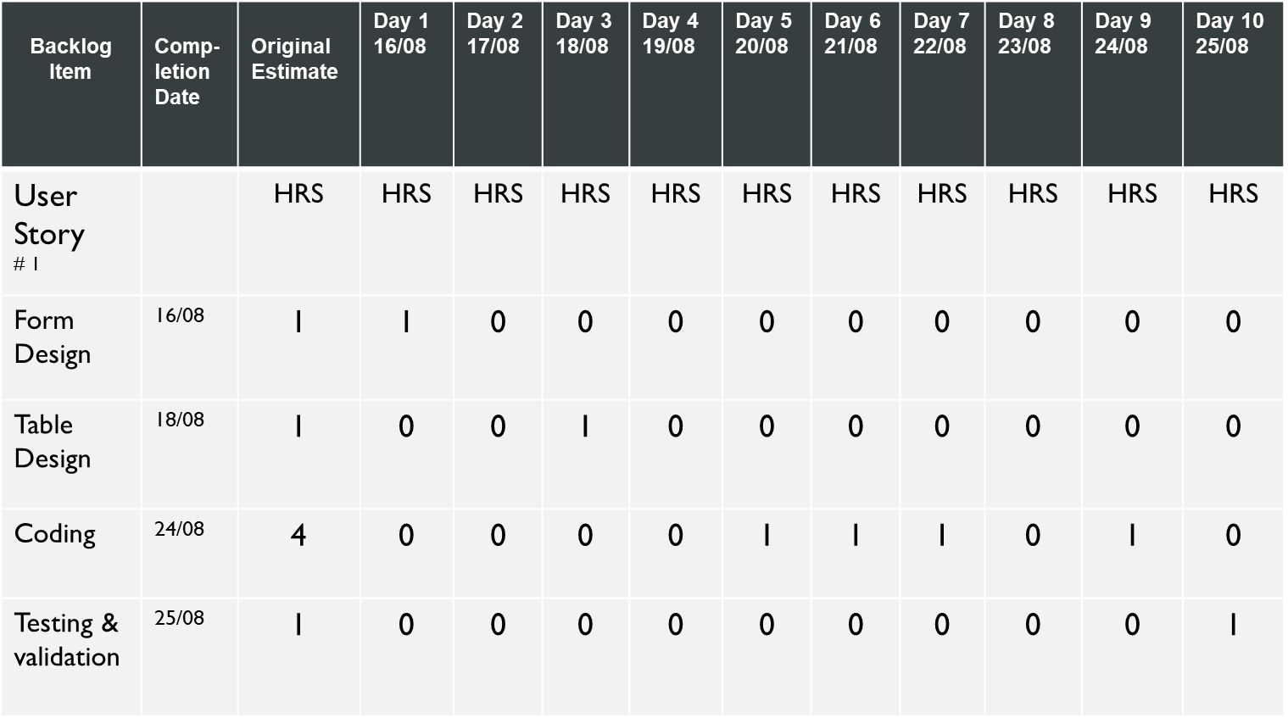
SPRINT PLAN

Slide 10
14

Slide 11
DEVELOPING ENVIRONMENT
HARDWARESPECIFICATION
Processor : Intel Pentium IV or above
HDD : 80 GB
RAM : 4 GB or above
SOFTWARE SPECIFICATION
Operating System : Windows 7 or above
Coding Language : Python
Front End :HTML
Back End : Mysql
Frame work : Django
IDE :VS Code
Browser :chrome/firefox/Explorer

